Slide 1
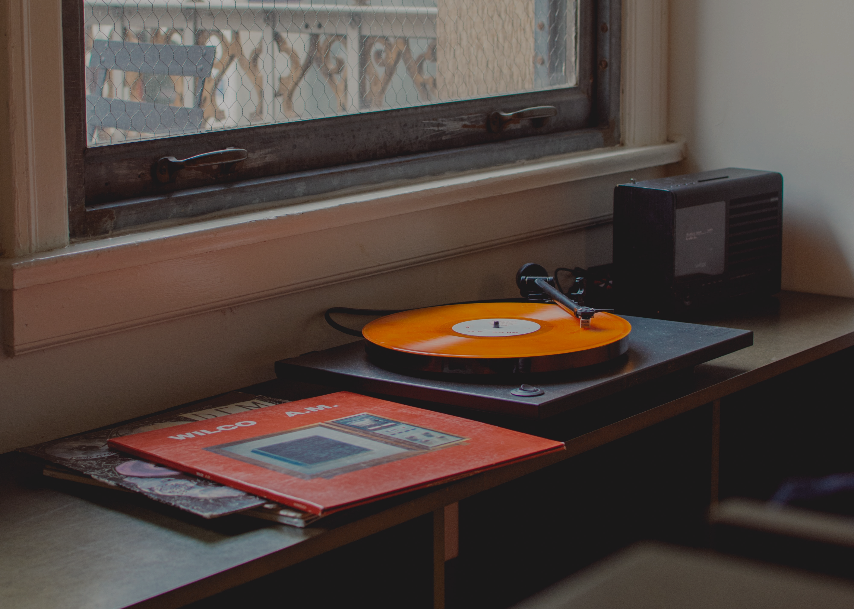

#DUMMY #UNKNOWN #PIT
Neque porro
quisquam
It has survived not only five centuries, but also the leap into electronic typesetting, remaining essentially unchanged. It was popularised in the 1960s with the release of Letraset sheets containing Lore

Slide 2
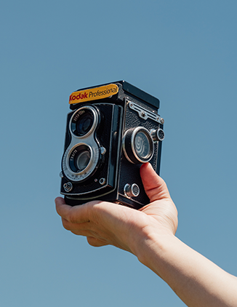
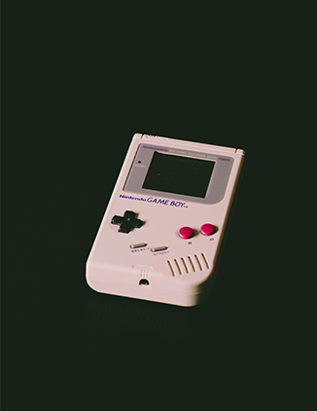
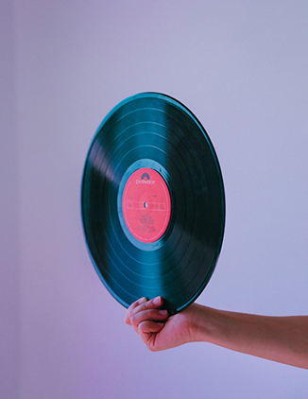
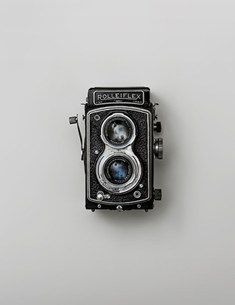
CONTENTS
ingeniis
Quidam
sermone
futuros
philosophi sermon
tractavissent
dam autem non tam id reprehendunt
philosophi Graeco sermone tractavissent
qui cum et probatus
videretur et

Slide 3
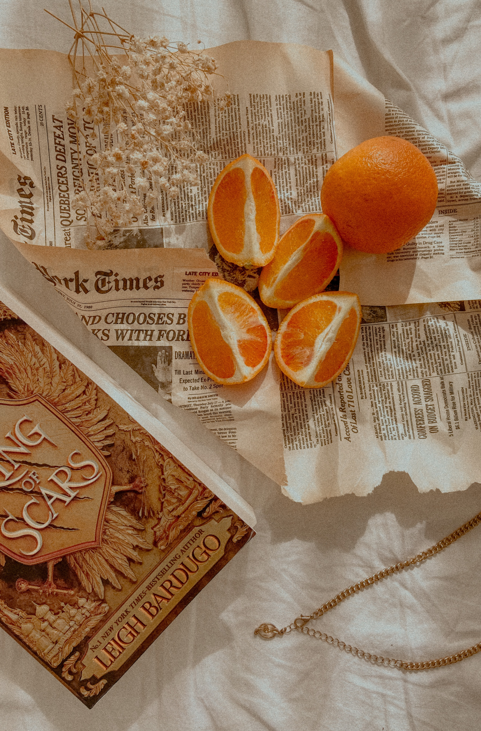
#MODERATIUS #PARANDA
Perveniri potest
non paranda
coerceri reprimique non potest
mediocritatem dnisi inveneris
esiderent
GRAECO SERMONE

Slide 4

#MODERATIUS #PARANDA
Perveniri potest
non paranda
coerceri reprimique non potest
mediocritatem dnisi inveneris
esiderent
GRAECO SERMONE

Slide 5
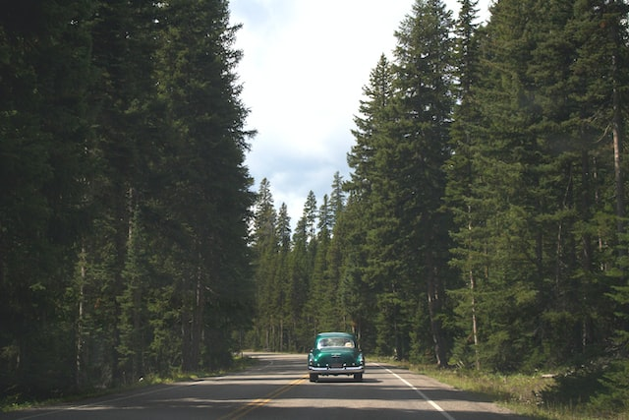
A QUIBUS TANTUM DISSENTIO
REPRIMIQUE NON POTEST
Moderatius
QUIS EST : tam INVIDUS NEMORE : qui
A quibus tantum dissentio, ut, cum Sophocles vel optime scripserit Electram, tamen male conversam Atilii mihi legendam putem, de quo Lucilius

Slide 6
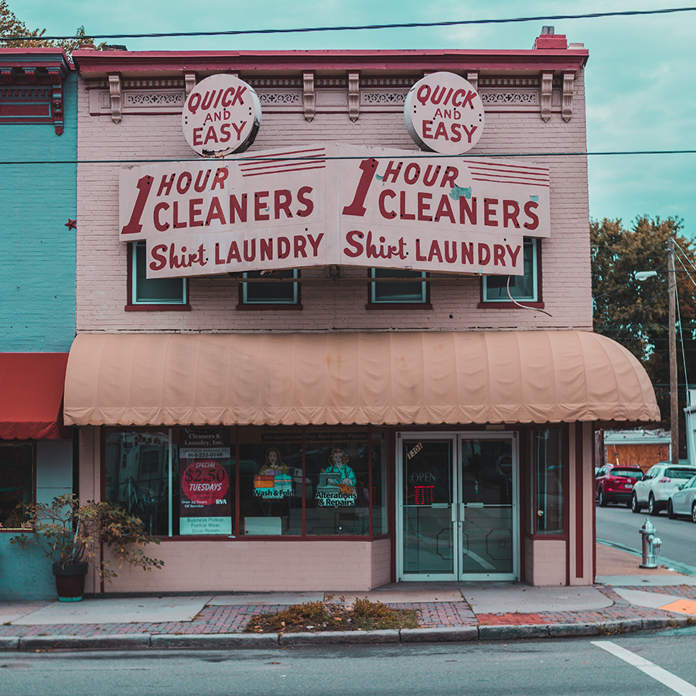
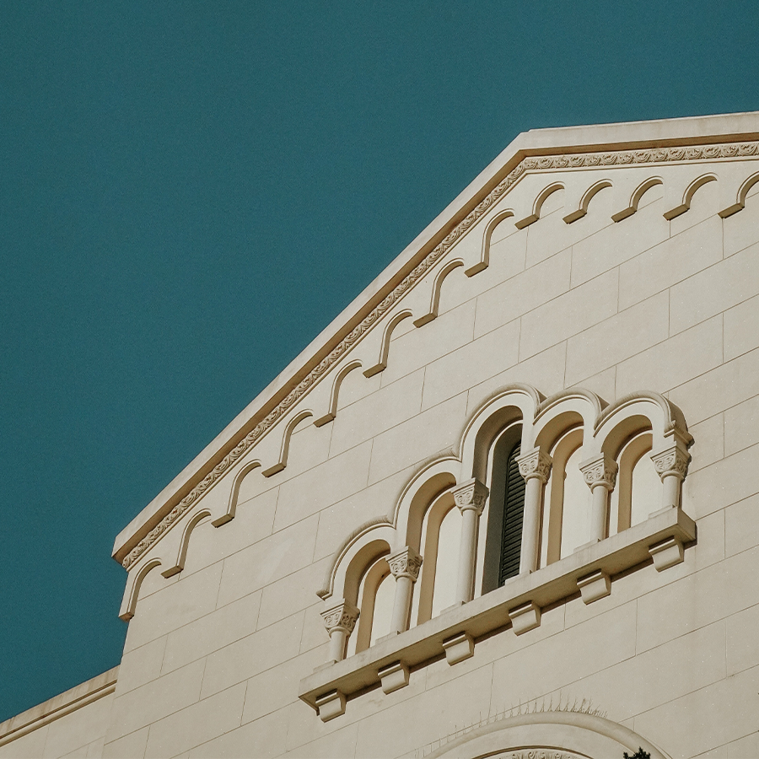


Et ii Quidem
Eruditi Graecis
est cur tam multos legant ut, cum
Sophocles vel optime
INVIDUS NEMORE
>

Slide 7

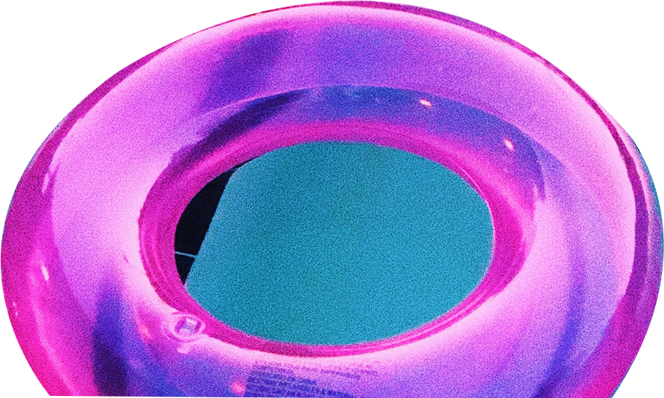
THANK YOU FOR
WATCHING

